Slide 1

6. Draw conclusions
Notes:
Teacher notes
This session helps students connect their results to their solution to form a conclusion.
It encourages students to think about what steps they could take next to continue their learning.
If students have not graphed or represented their results clearly so they can be shared with an audience, please use session 5.
This is the final step of the problem-solving process. They have been designed to form a basis for a one-hour session, but they can be used flexibly and adapted to suit the needs of your class. The seventh lesson provides further information on entering Google Science Fair.

Slide 2

1
2
3
4
5
7
Identify a problem
Generate ideas
Develop a solution
Design the test
Communicate the results
Draw conclusions
Enter the competition

Slide 3
Session 6: Outline
Results summary Connecting your results to the solution Unexpected results Activity 1: Reflection & feedback Activity 2: Writing your conclusion
5 mins 15 mins 5 mins 15 mins 15 mins
05 06 07 10 11

Slide 4
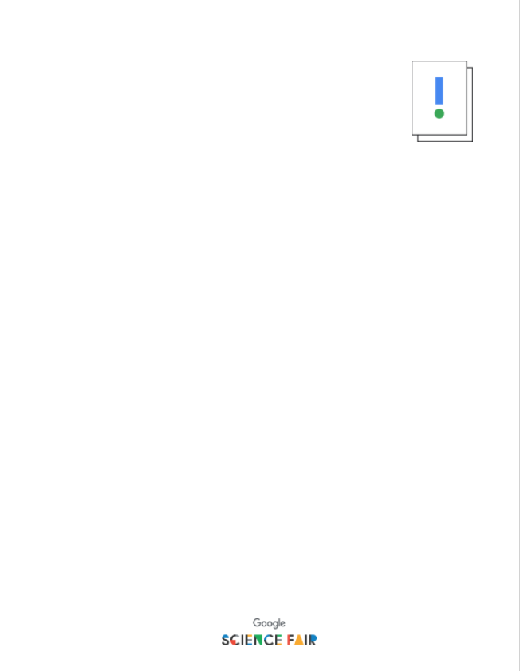
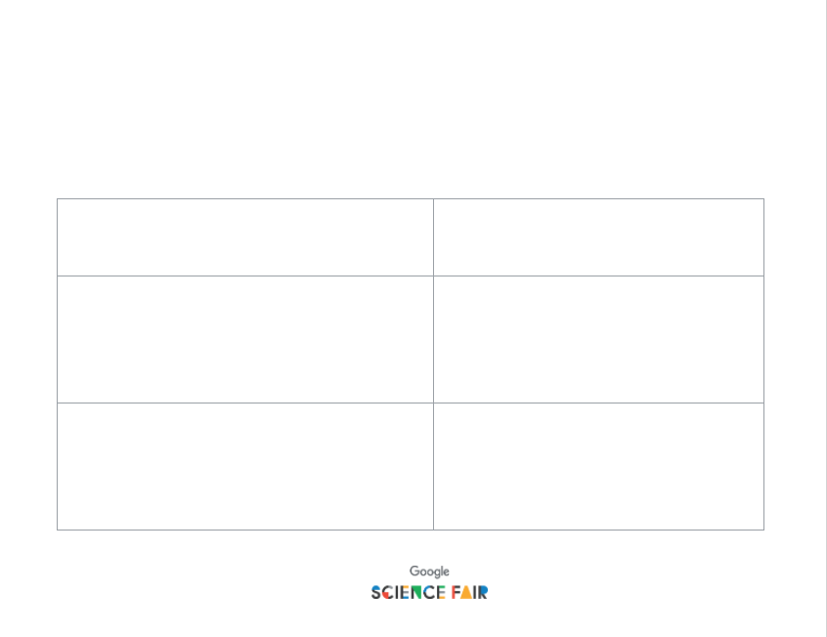
Materials you’ll need
A clearly communicated set of results Writing supplies Activity 1: Reflection and feedback Activity 2: Writing your conclusion

Slide 5

Remind yourself of your results
What clear message does your data communicate?
Notes:
Teacher notes
Students reflect on their results and the 100-word summary they wrote in session 5.
If session 5 was not completed, students should write a 100-word summary of their results.
What clear message do they want their audience to understand from the data they have collected?

Slide 6
results + solution = conclusion
Link your results to the solution you developed to create your conclusion.
The data shows… My results display… There is a clear trend… From the graph you can see… My testing shows… The prototype demonstrates…
...proving that… …this links to… …showing that… …this validates… …providing evidence that… …justifying...
Notes:
Teacher notes
Students need to link what their results show to the solution and the problem this set out to solve.
Students can use the sentence stems to help them formulate a conclusion.
How does the data support their solution?

Slide 7
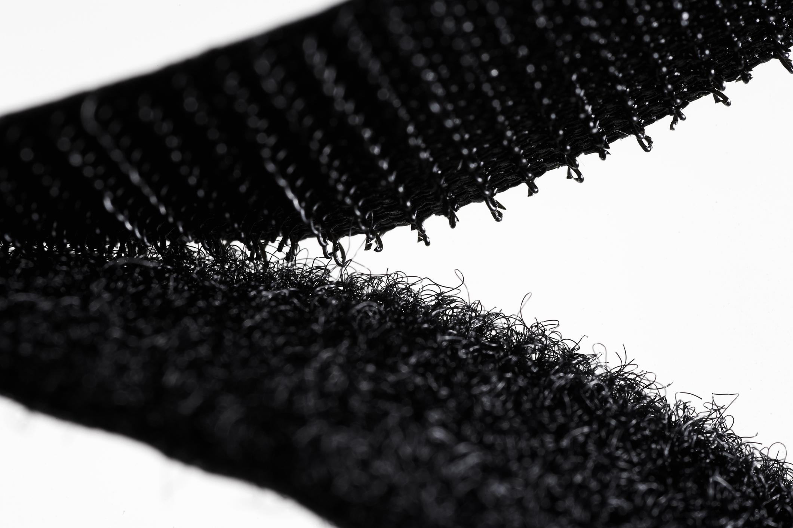

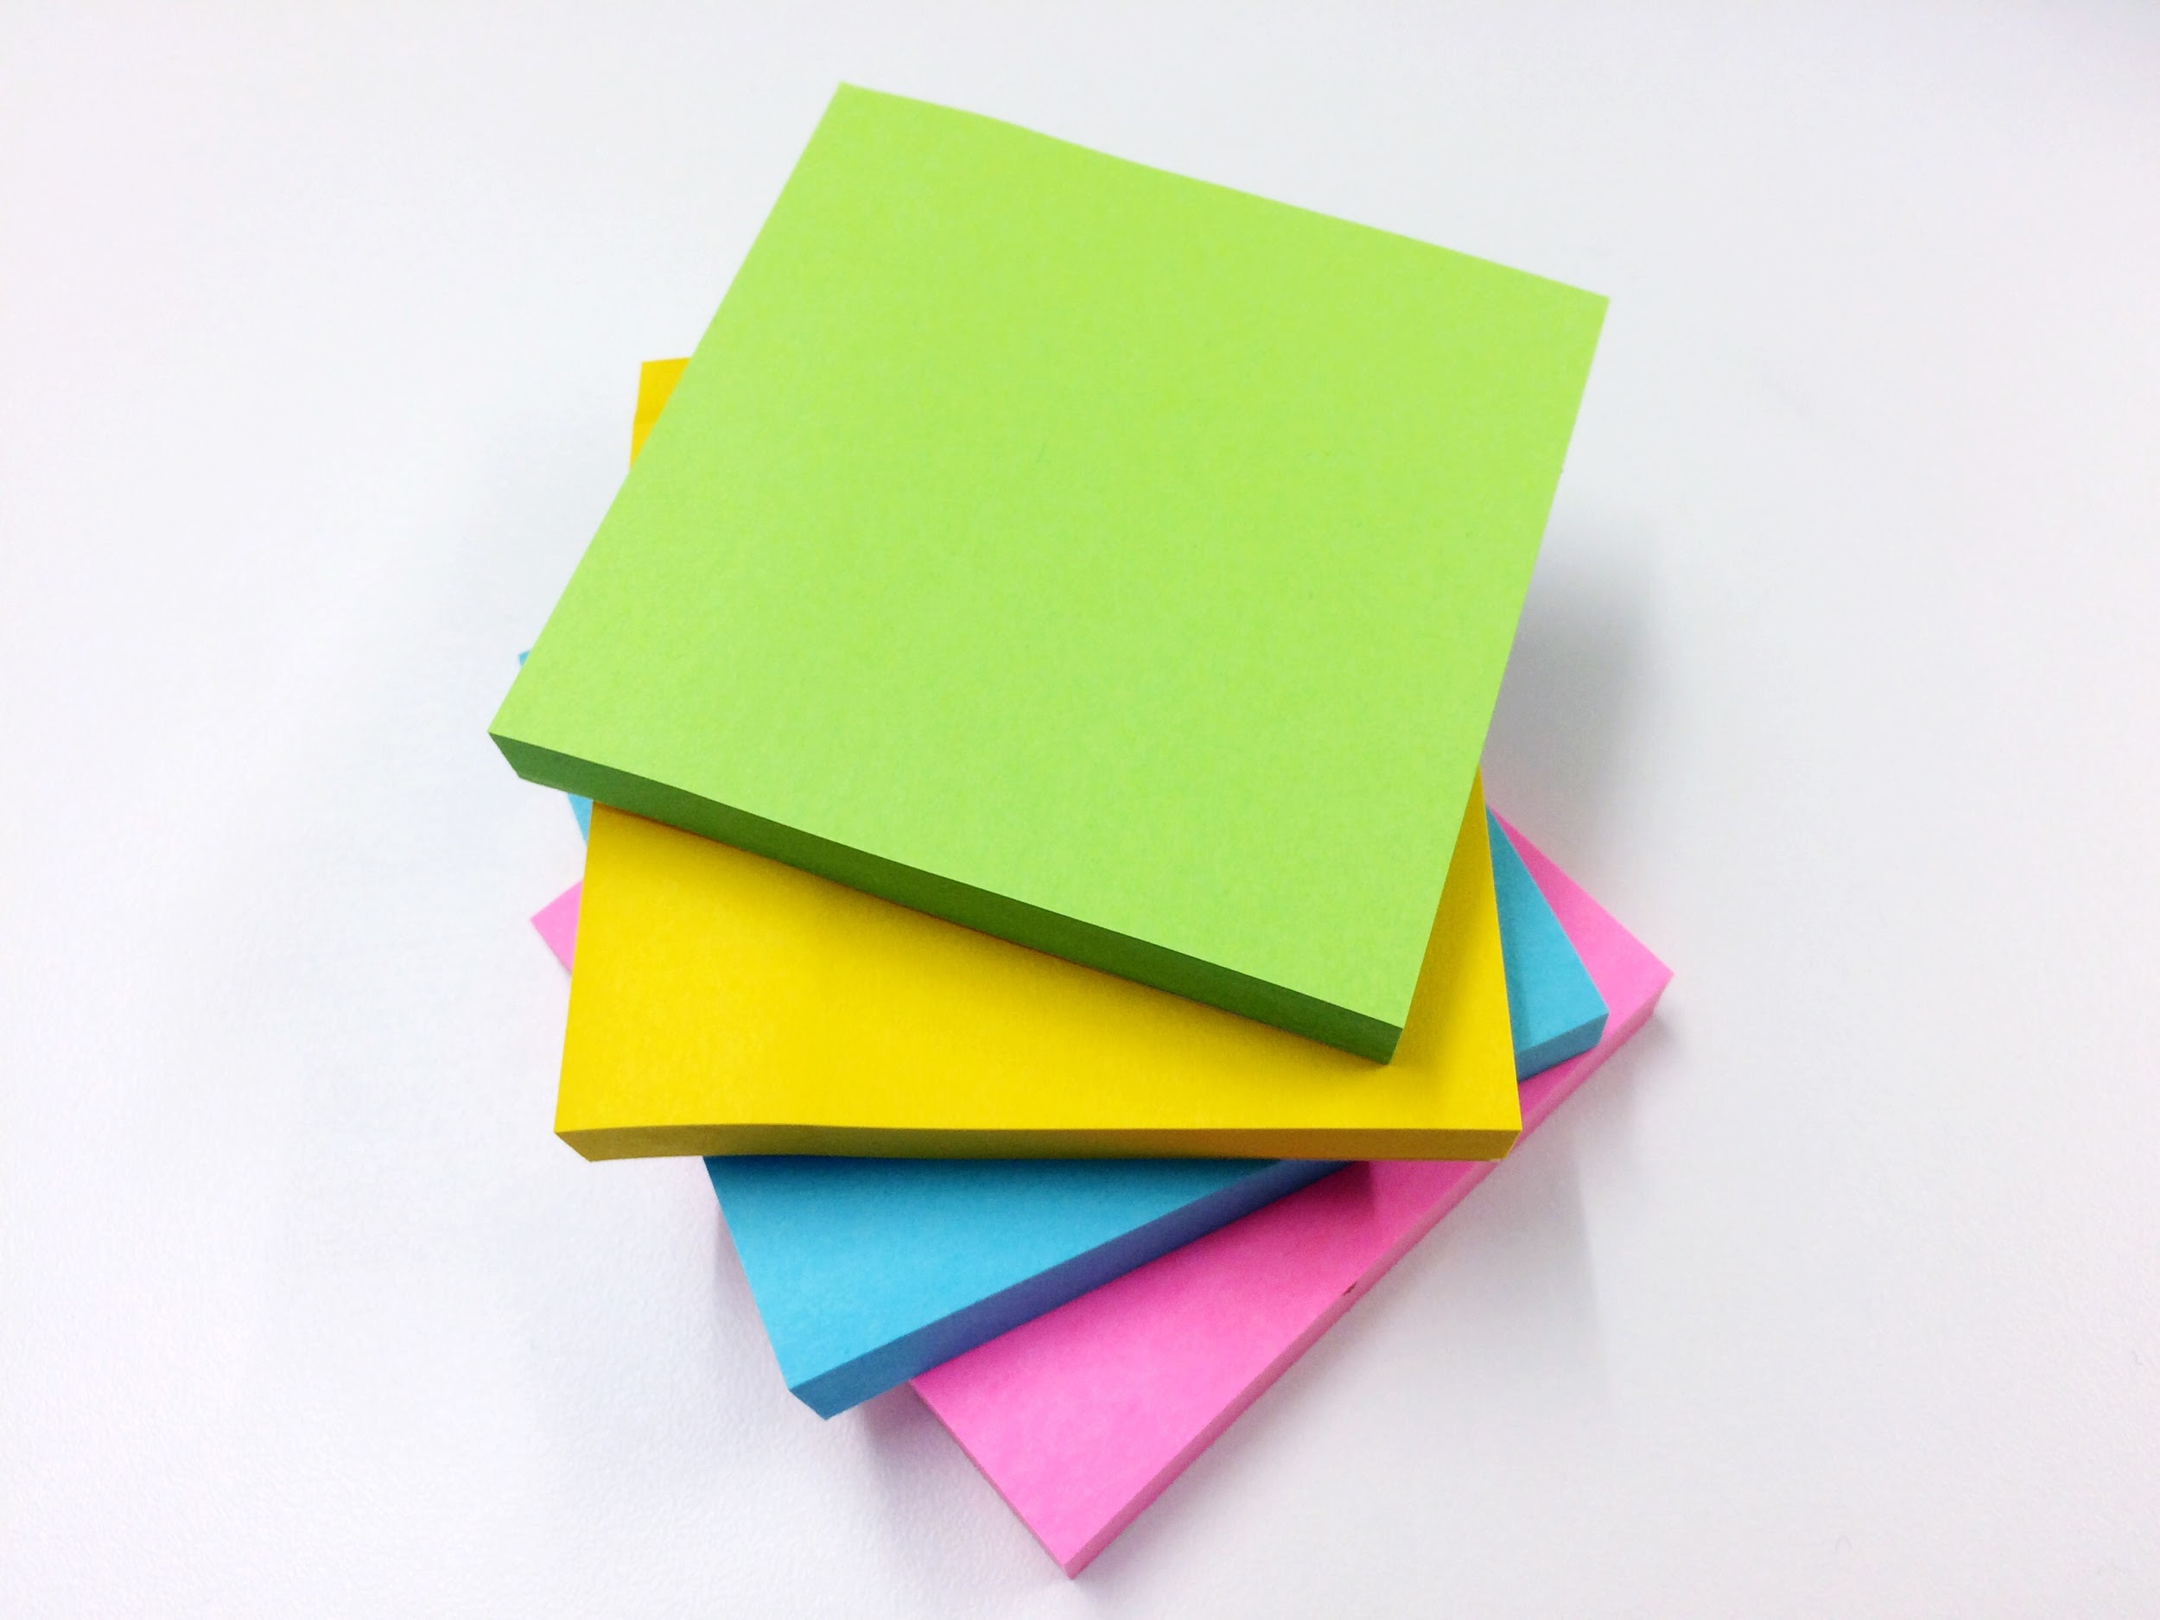
What if my results don’t support my solution?
Here are some inventions that came to be by accident.
Velcro
Pacemaker
Post-its
Notes:
Teacher notes
Explain to students that it’s ok if they didn’t get the results they expected - this is normal and can often work to your advantage, as these examples show.
It could also be that it didn’t work this time, but that the data gives valuable insight into what to do next - look at Elif as an example of this.

Slide 8
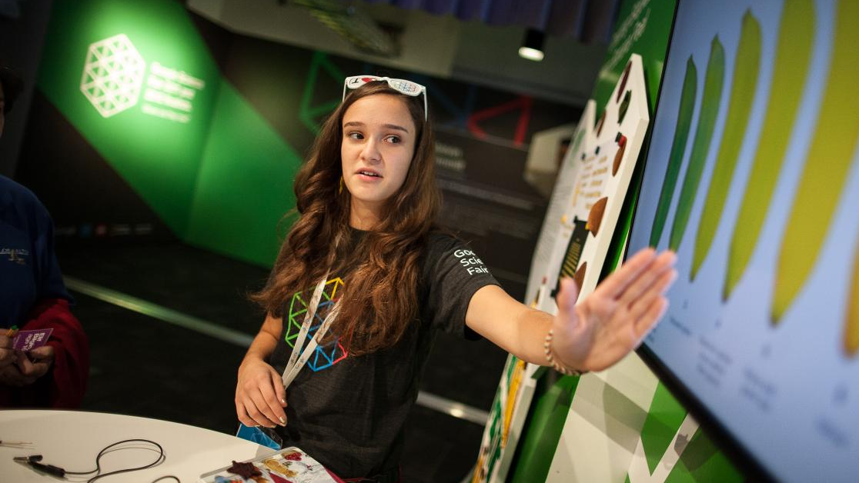

Case study
Elif Bilgin
Age 16
She had to do her experiment more than once — but she learned from each iteration. Check out her project.

Slide 9
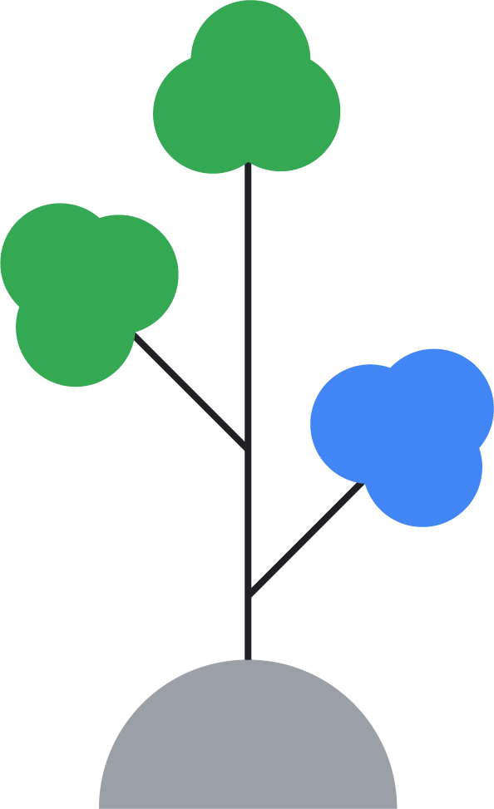
What do your results show?
Were there any unexpected results — why do you think they occurred?
Can you relate your results to something else?
Do your results mean you need to change something?
Notes:
Teacher notes
Encourage students to look at their data and find what it does tell them.
What do they know now that they didn’t before?
Does the data push them to alter something in their solution?
Or, does the data take their solution in a totally different direction?
Explain that to have a valid project for Google Science Fair, it doesn’t matter if they didn’t find what they expected, as long as they can explain it and use it to draw appropriate conclusions.

Slide 10

Activity 1: Reflection & feedback
Reflect on your project and a friend’s project
What works well? What could be even better? Consider:
How clearly is the idea explained? Can you understand it?
Is the solution sensible? Is there a clear impact?
Can you understand how the prototype works?
Do you understand how the idea was tested?
Do the results support the solution?
If they don’t, why?
Notes:
Teacher notes
Ask students to swap their project with a peer (preferably in pairs who know little about each other’s projects).
They should complete Activity 1: Reflection activity & feedback and then feedback their thoughts to each other.
If time is available, some ideas could be shared with the class.

Slide 11
Activity 2: Writing your conclusion
Writing your conclusion
To create a good conclusion, use the structure of results + solution. However, you should also reflect back on your work and look ahead to what you could do next. Ask yourself:
What could I have done differently?
Has this brought up any new ideas or insights?
What are my next steps?
Notes:
Teacher notes
Hand out Activity 2: Writing your conclusion.
Now that students have reflected on their own project and given insight to a peer’s, they are in a position to finish. Finally, ask students to think about:
With hindsight - what would they change?
If they could do the project again, would they go about it exactly the same way?
Is there something else they want to explore?
Did the results also give a new and interesting finding?
Has feedback from peers provided new insight?
What are they going to do next? Prioritizing steps is a good way to make sure they actually happen.

Slide 12

Time to submit!
Now you have your full project, it’s time to share it! Look at GoogleScienceFair.com to see finalists and winners from previous years. This is a great way to get inspiration for presenting your project.
Sign up and start adding your project. Make sure you check the official rules and know when the competition closes so that you don’t miss out on Google Science Fair!
Notes:
Teacher notes
To enter Google Science Fair, students need to be between 13 and 18 years-old and have a Gmail account.
It’s completely free to enter.
They will need to get parental consent.
They will need to abide by the official rules of the competition.

Slide 13
Now that you have your conclusion, it’s time to enter your project!
7. Enter the competition

